Slide 1


HALISI
APP
By Halisi Group · Chiromo Tech Club . University of Nairobi
OCTOBER 2026

Slide 2
TABLE OF CONTENTS
01
Introduction & Methodology
05
Potential Impact & Target Profiles
02
The Problem & Market Need
06
The Team & Execution
03
The Solution & Creativity
07
Business Potential & Road Ahead
04
Technical Complexity

Slide 3

INTRODUCTION
Halisi is an AI-powered brand defense platform that protects Kenyan social commerce merchants and everyday shoppers from digital impersonation and mobile money fraud.
Concept & Methodology: We fuse computer vision, natural language processing, and transaction verification into a 5-signal composite forensic engine. By analyzing visual identity (dual pHash/dHash and CLIP neural embeddings), phonetic handle distance, Kenyan Sheng/Swahili scam cues, and rogue M-Pesa channels, Halisi delivers instant forensic verdicts (<1s) and one-click legal takedown playbooks before fraud occurs.

Slide 4
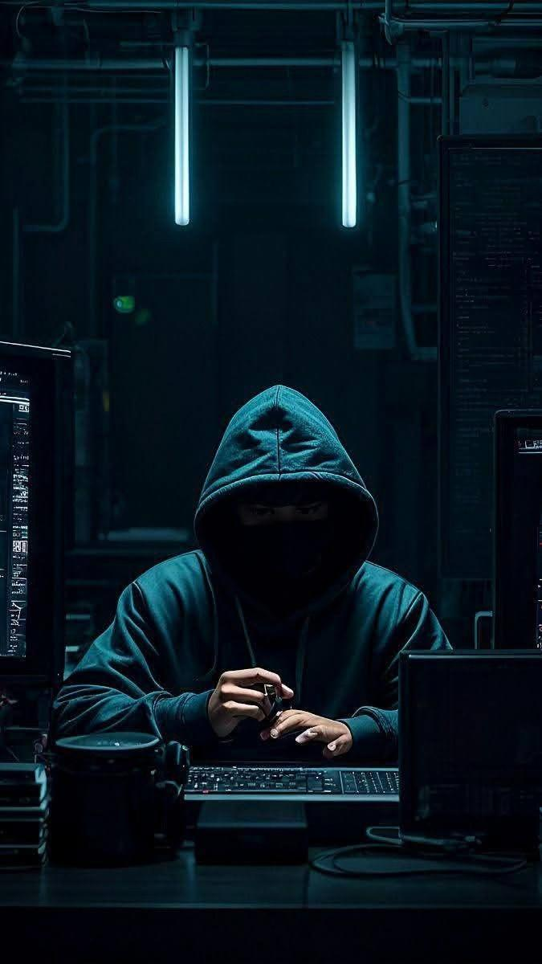
THE PROBLEM
Kenya's booming social commerce (Instagram, TikTok, Facebook) runs on mobile money and seller trust. Fraudsters exploit this by creating pixel-perfect clone accounts that hijack authentic brand logos and usernames, undercutting prices to deceive unsuspecting buyers into sending money to personal lines, unverified Tills, or Pochi la Biashara. Over KSh 3.2B is lost annually to cyber fraud, yet existing platform reporting takes weeks, leaving buyers robbed with zero recourse and destroying merchant reputation. Halisi replaces slow, manual reporting with instant, proactive verification—stopping fraud before money moves.

Slide 5




THE SOLUTION
Halisi is the first platform engineered specifically for Kenya's mobile financial reality. Instead of relying solely on generic domain blacklists, Halisi cross-references suspect pages against verified M-Pesa Tills, Paybills, and Pochi accounts, detecting payment asymmetry alongside Sheng/Swahili urgency language ('lipa deposit kwanza').
Our engine computes a calibrated 5-dimension forensic score with strict confidence gating to prevent false positives against honest competitors. On detection, Halisi automatically drafts court-ready evidence dossiers (SHA-256 bundle hash) and platform takedown notices under the Computer Misuse and Cybercrimes Act 2018.

Slide 6


TIERED INGESTION
TECHNICAL COMPLEXITY
Multi-tiered async scraper with SSRF protection. Tier 1 matches cached pgvector records; Tier 2 deploys an OpenGraph crawler with crawler headers to bypass login walls; Tier 3 provides manual assist.
Halisi's architecture combines cutting-edge neural embeddings, dual perceptual hashing, and resilient distributed crawling to extract identity signals in real time.
VISUAL & PAYMENT AI
Normalizes logos (EXIF, alpha-to-white, square pad) and extracts 64-bit pHash + dHash alongside 512-d CLIP ViT-B-32 embeddings. Regex engines extract Kenyan phone, Till, Paybill, and Pochi numbers.
LINGUISTIC NLP
Analyzes bios for localized urgency cues ('lipa deposit kwanza', 'hurry offers') using a weighted Kenyan lexicon, combined with phonetic handle homoglyph matching (e.g. '1' for 'l').

Slide 7


COMPOSITE SCORING
Scores 5 dimensions (Visual, Identity, Payment, Language, Account) with dynamic confidence weighting. Employs overrides (O1–O4) for typosquats and rogue tills, plus Gate G1 to protect legitimate competitors.
FORENSIC VERDICT
Delivers sub-second verdicts (HALISI, FEKI, ONYO, HAIJULIKANI) through an Apple Design-inspired interface featuring fluid spring motion, translucent glassmorphism, 64-bit bit-diff grids, and compare sliders.
AI REMEDIATION
Integrates NVIDIA NIM (Llama 3.1 8B Instruct) to generate factual, bilingual (EN/SW) takedown playbooks and tamper-evident PDF dossiers with canonical SHA-256 evidence hashes for law enforcement and KE-CIRT/CC.

Slide 8



POTENTIAL IMPACT & USERS
Kenyan Merchants (SMEs)
Everyday Shoppers
Regulators & Ecosystem
Over 100,000 SMEs selling on Instagram and TikTok. Halisi acts as their automated Brand Protection / Content ID, monitoring look-alike handles, stopping clone revenue theft, and defending customer trust with Halisi Verified certificates.
Millions of Kenyan mobile money consumers. The zero-friction 'Check before you Lipa' single-field scanner empowers buyers to verify any handle or Till in seconds, completely eliminating blind payments to fraudsters.
Trust & Safety teams at Meta and TikTok, plus KE-CIRT/CC, CAK, and Safaricom Fraud. Halisi replaces vague user complaints with structured, cryptographically validated evidence packs ready for immediate enforcement.

Slide 9
THE TEAM & ROLES
01
Siganga Ndegwa
Frontend Architecture · Apple Design Interface & Data Layer
02
Collins Kimanzi
Project Lead · Detection Engine, CLIP AI & Composite Scorer
03
Geoffrey Obwocha
Backend API · Supabase pgvector, Distributed Crawler & Alerts

Slide 10

BUSINESS MODEL & ROAD AHEAD
Layer 1 is a free public consumer utility driving viral adoption and scam telemetry. Layer 2 is B2B SaaS for Kenyan businesses ($15–$50/mo) providing 24/7 clone monitoring, instant threat alerts, and automated takedown packages.
Preventing a single clone attack saves a merchant hundreds of thousands of KSh in diverted sales and preserves customer lifetime value. Additional monetization includes B2B API verification licensing for fintechs, banks, and e-commerce checkouts.
Direct Meta Rights Manager API automated takedowns, live Safaricom Daraja M-Pesa owner validation, and regional expansion across East Africa's mobile commerce corridor.

